Slide 1

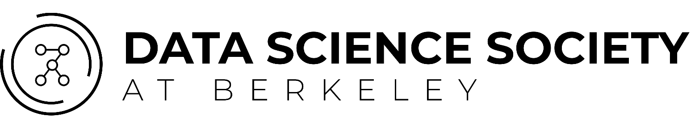
StreamSage 2.0
Final Deliverable
×

Slide 2

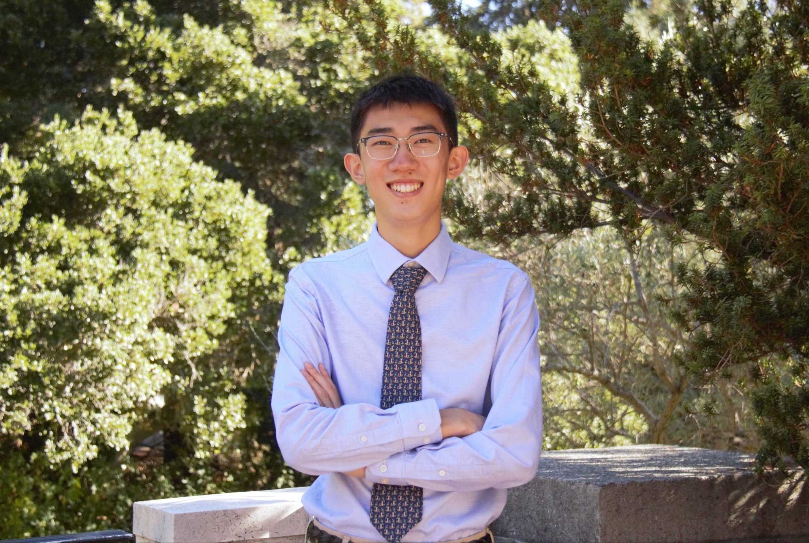

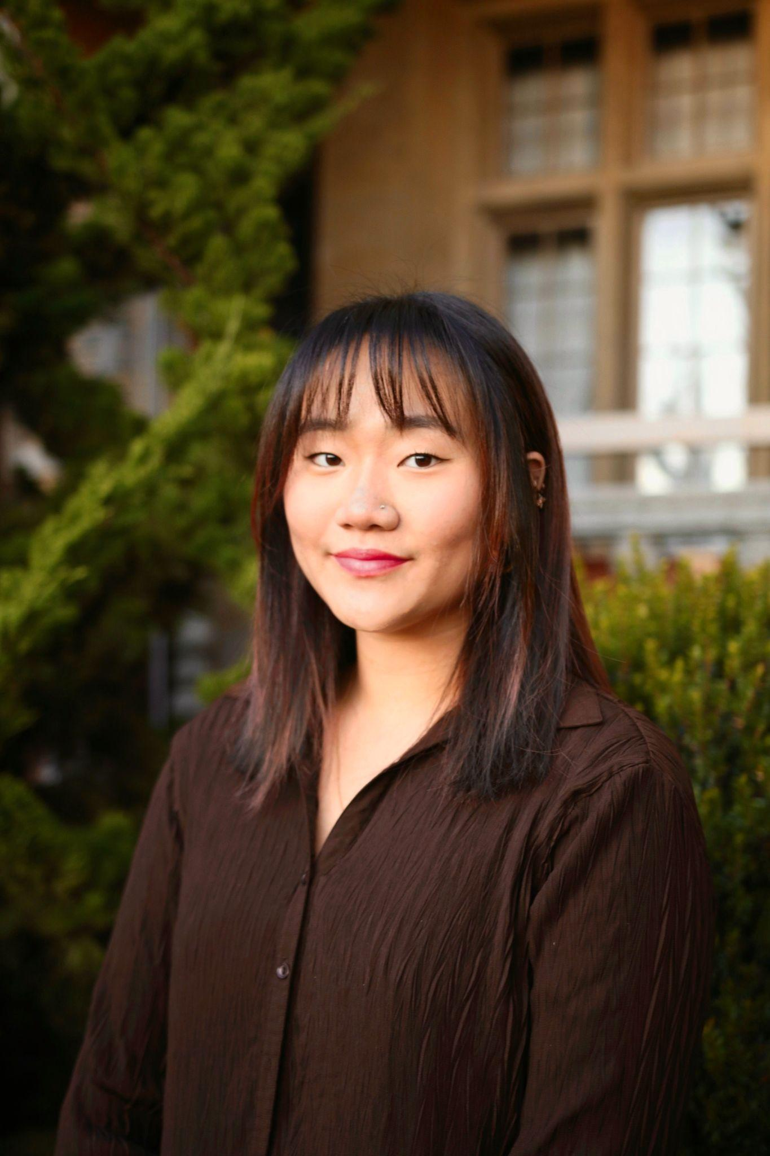

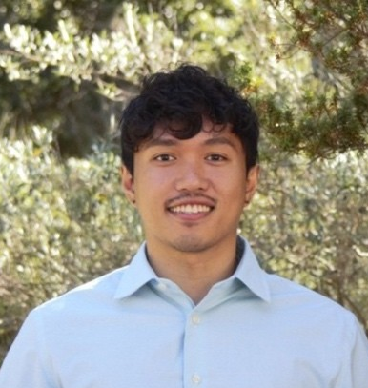

Meet the Team
Christiana Kang
Project Manager
Nathan Kuo
Project Manager
Marianne Choi
Consultant
Sooyeon Kim
Consultant
Mark Barranda
Consultant
Ashley Watanabe
Consultant

Slide 3
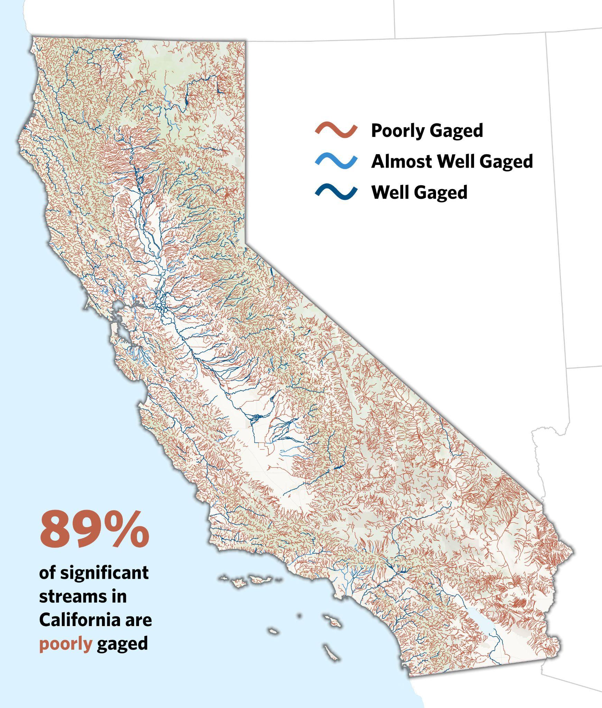
Background & Purpose
What?
Predicting daily water flow in streams that may not have active gages
How?
Numerical modeling using similarity ranking and dynamic windowing
Why?
Inform water policy decisions and conservation efforts across California
Notes:
Nathan

Slide 4
Expert Rescale

Slide 5
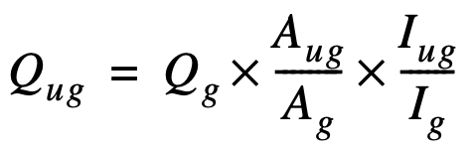
Expert Recale Overview
Q: stream flow value
ug: ungaged (target location), g: gaged (reference location)
Ratio of drainage areas (A)
Larger drainage area → more flow relative to reference
Ratio of mean annual precipitation (I)
Higher MAP → more flow relative to reference
Notes:
Marianne
Scale streamflow (Q) of reference gage (g) to estimate the unknown flow at the target gage (ug)
Ratio of drainage areas (A)
Larger DA → more flow relative to reference
Ratio of mean annual precipitation (I)
Higher MAP → more flow relative to reference
USGS paper

Slide 6
Reference Gages Selection

Slide 7
Similarity Measure
Reference Gauge (B)
Feature Embedding/Vectorization:
Normalize feature vectors to account for different scales.
Similarity Metrics:
Utilize Euclidean distance to quantify the similarity between gages.
Closer (smaller) distances in vector space imply higher similarity.
Reference Gages:
Select similar gages (e.g., B and D) as reference points for each target gage to improve prediction accuracy.
Target Gauge (A)
Reference Gauge (D)
Reference Gauge (C)
With Similarity Measure:
→ Each gage has its own unique reference gage group of n size
A
B
D
C
D
G
A
H
Notes:
Sooyeon

Slide 8
Weight Assignment
Our Implementation:
target variable is continuous → linear regression model
coefficients assigned as weights to each feature
** cannot use ‘PRECIP’ or ‘totdasqmi’
Features & Weights:
1 / DISTANCE | 0.68 | 1 / distance between reference gage and target gage calculated using haversine formula
'MINBELEV' | 0.16 | minimum basin elevation
'JANMAXTMP' | 0.16 | maximum temperature in January of stream gauge
'RELIEF' | 0.16 | maximum - minimum elevation
'ELEVMAX' | - 0.16 | maximum elevation near the stream gauge
Alternative Implementation:
random decision trees and recursive feature elimination
custom RFE function to select features and determine weights that maximize KGE and R2
** computationally intensive
Notes:
Sooyeon

Slide 9
Dynamic Windowing

Slide 10
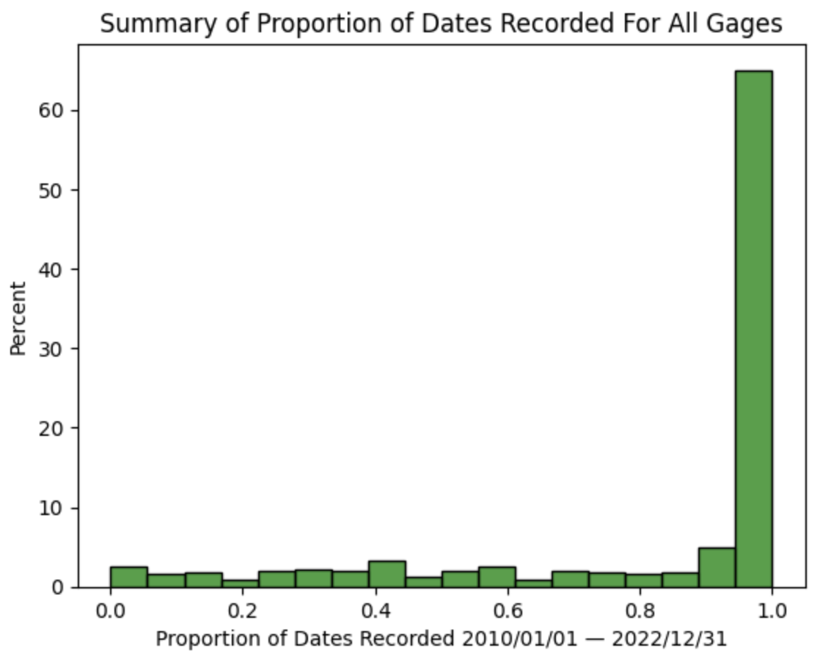
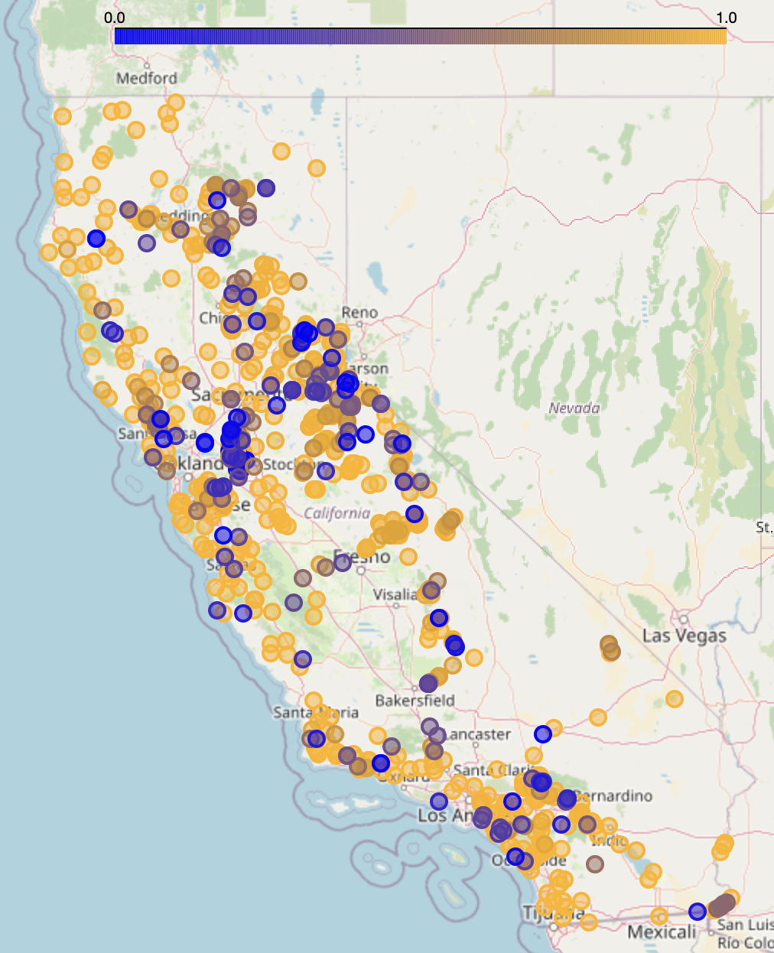
The Problem
proportion of dates recorded
Notes:
Nathan

Slide 11
The Goal
Problem
Not all gages recorded flow data on every date
Solution
?
Goal
Constant n reference gages for each date to compute average
Notes:
Nathan

Slide 12
Dynamic Windowing
Solution
Analyze the top n most similar gages on a day-by-day basis
date | gage_1_id | gage_1_ pred_flow | gage_2_id | gage_2_ pred_flow | gage_3_id | gage_3_ pred_flow | avg_gage_pred_flow
2010-01-01 | 1000 | 1 | 2000 | 2.5 | 3000 | 2.5 | 2
2010-01-02 | 1000 | 1.5 | 3000 | 4 | 4000 | 1.5 | 2.33
2010-01-03 | 1000 | 1.5 | 2000 | 2.5 | 3000 | 2 | 2
2010-01-04 | 2000 | 2 | 3000 | 2.5 | 4000 | 0.5 | 1.67
Notes:
Nathan

Slide 13
Performance

Slide 14
Measuring Expert Rescale Performance
KGE
(Kling-Gupta efficiency)
R²
(coefficient of determination)
Assesses the similarity between observed and simulated hydrological data
Considers correlation, variability, and bias of data (less sensitive to outliers)
Measures the proportion of the variance in the dependent variable that is explained by the independent variable
Measures the strength of the relationship between observed and predicted values (sensitive to outliers)
Notes:
R
2
provides a measure of the proportion of the variance in the dependent variable that is explained by the independent variables. A higher
�2
R
2
value indicates a better fit of the regression model to the data.
KGE provides a comprehensive measure of the agreement between observed and simulated data in hydrological modeling. A higher KGE value indicates better agreement between observed and simulated data, considering aspects of correlation, bias, and variability.

Slide 15
Interpretation of KGE & R²
KGE range
-∞
0
1
KGE = 1 indicates perfect agreement between observed and simulated data.
KGE < 0 indicates that the model performs worse than a reference model that predicts the mean of the observed data.
R² range
0
1
R2 = 1 indicates that the model perfectly predicts the dependent variable.
R2 = 0 indicates that the model does not explain any of the variability in the dependent variable and is essentially equivalent to using the mean of the dependent variable as the predictor.
Notes:
R
2
provides a measure of the proportion of the variance in the dependent variable that is explained by the independent variables. A higher
�2
R
2
value indicates a better fit of the regression model to the data.
KGE provides a comprehensive measure of the agreement between observed and simulated data in hydrological modeling. A higher KGE value indicates better agreement between observed and simulated data, considering aspects of correlation, bias, and variability.

Slide 16
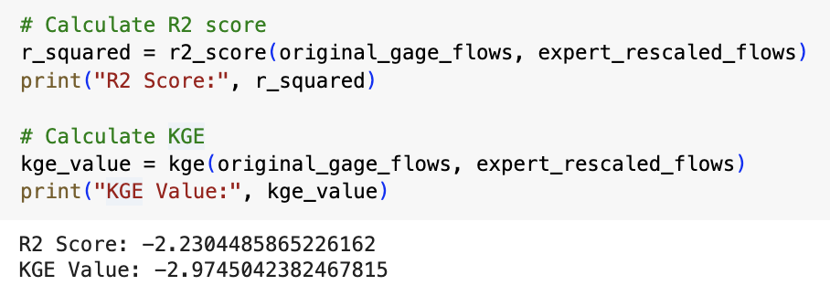
Models Comparison Pipeline
gage id | Model 1 KGE | Model 1 R² | Model 2 KGE | Model 2 R²
11014000 | -0.178879 | 0.168024 | -13.30231 | -3.729540
… | … | … | .. | …
… | … | … | .. | …
… | … | … | .. | …
… | … | … | .. | …
… | … | … | .. | …
… | … | … | .. | …
… | … | … | .. | …
Model 1
(e.g. upstream)
Apply performance metric on a sample set of unique gages
Model 2
(e.g. expert recale with weight assignment)

Slide 17
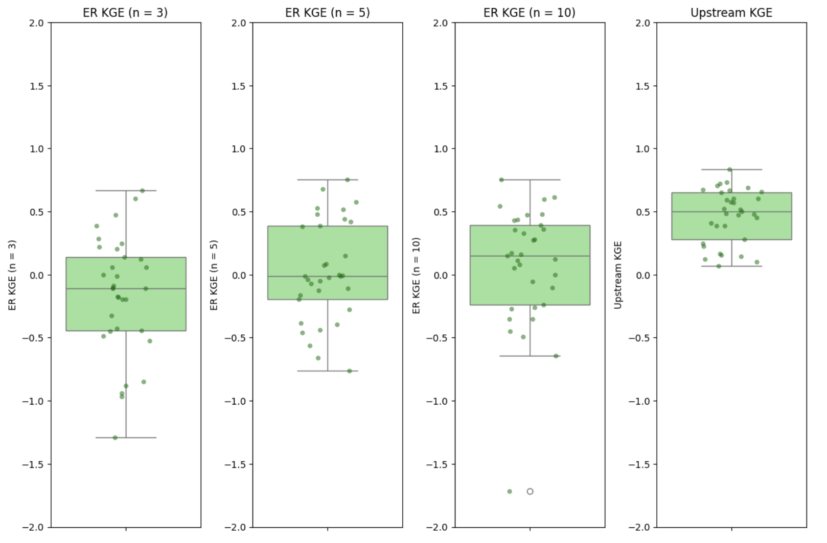
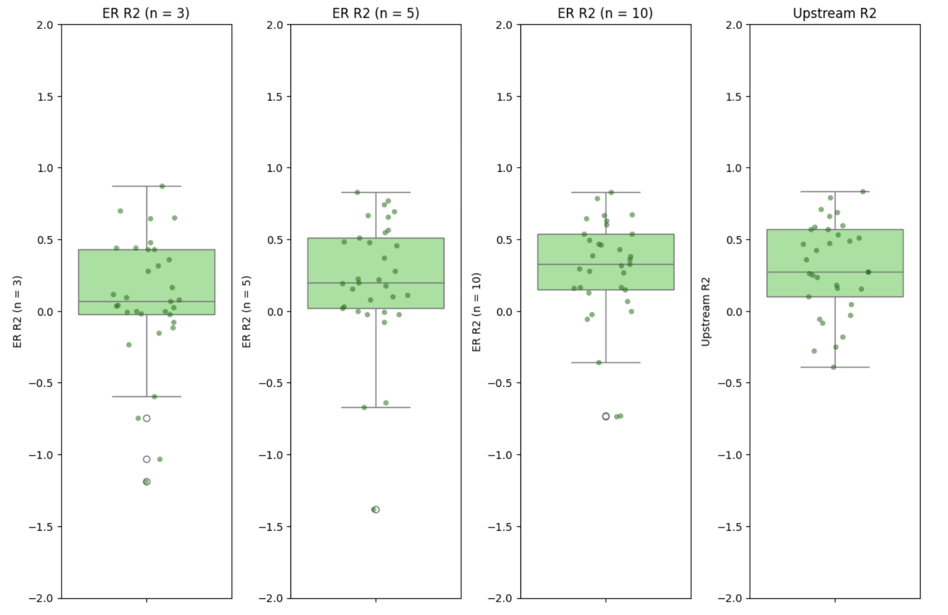
Upstream vs Expert Rescale
start date = 01/01/2022
end date = 12/30/2022
Average KGE Score:
Average R2 Score:
Expert Rescale (n = 3) | -0.160
Expert Rescale (n = 5) | 0.022
Expert Rescale (n = 10) | 0.067
Upstream | 0.466
Expert Rescale (n = 3) | 0.076
Expert Rescale (n = 5) | 0.204
Expert Rescale (n = 10) | 0.283
Upstream | 0.302

Slide 18

Streamlit

Slide 19
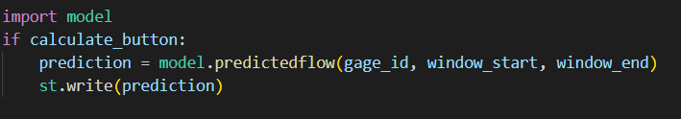
What is Streamlit?
Open-source Python framework to create interactive app
Can be deployed on Streamlit Community Cloud, Docker, Kubernetes
Have integration with Snowflake (Support SQL & Big database)
Flexible
Easy to code
Notes:
Mark

Slide 20
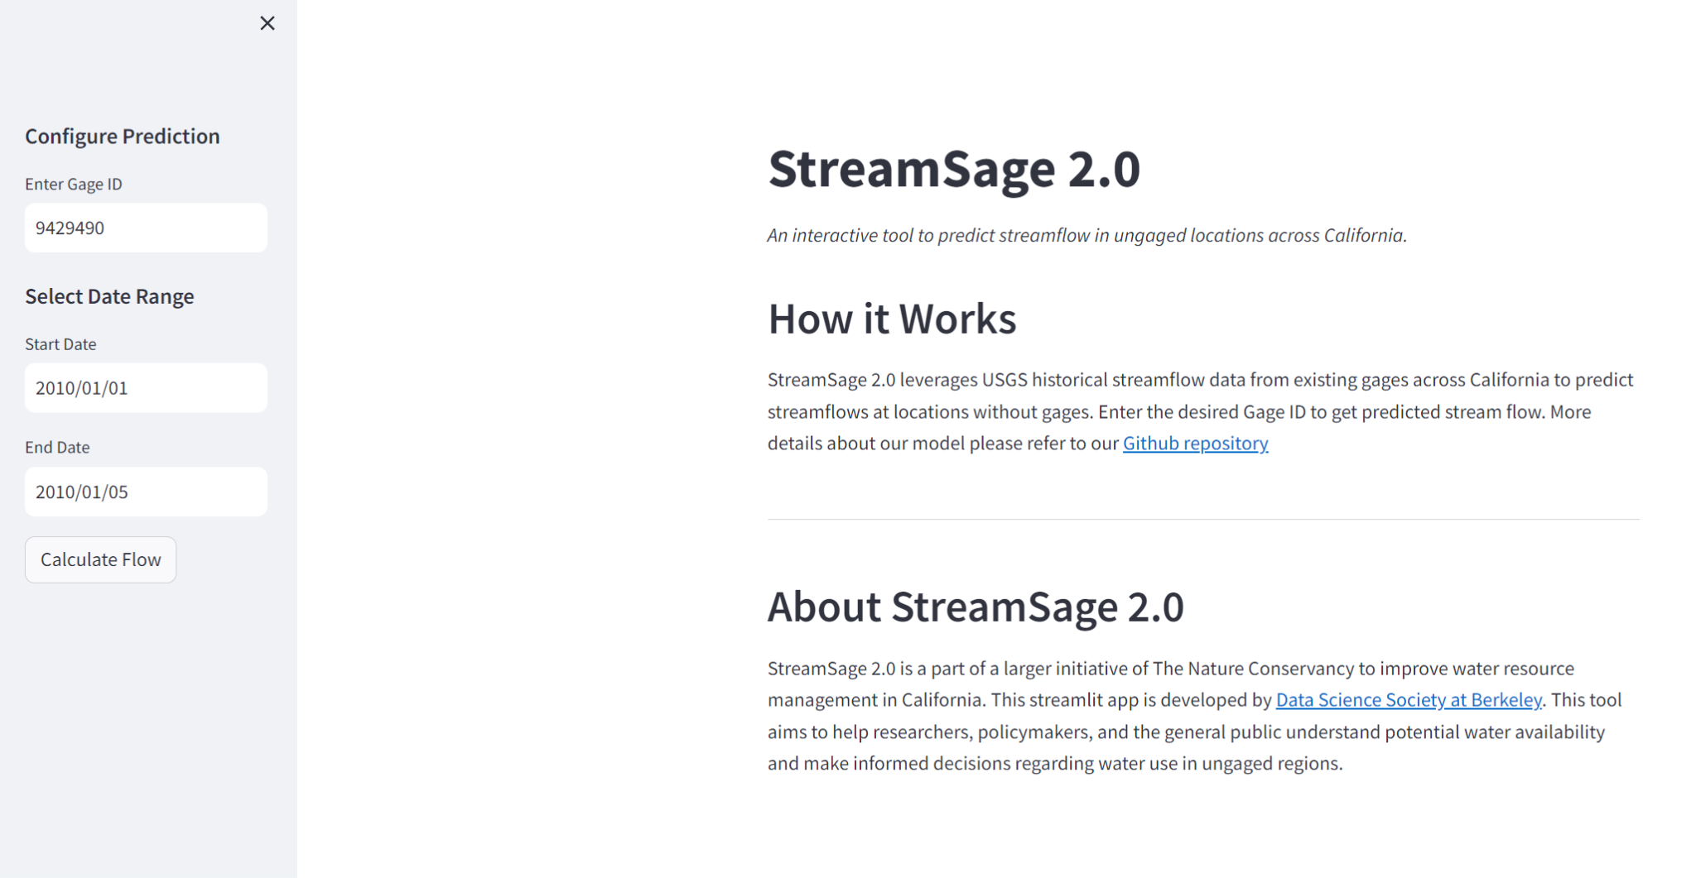
Demo
Notes:
Mark

Slide 21
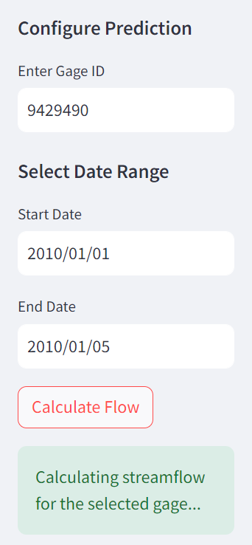
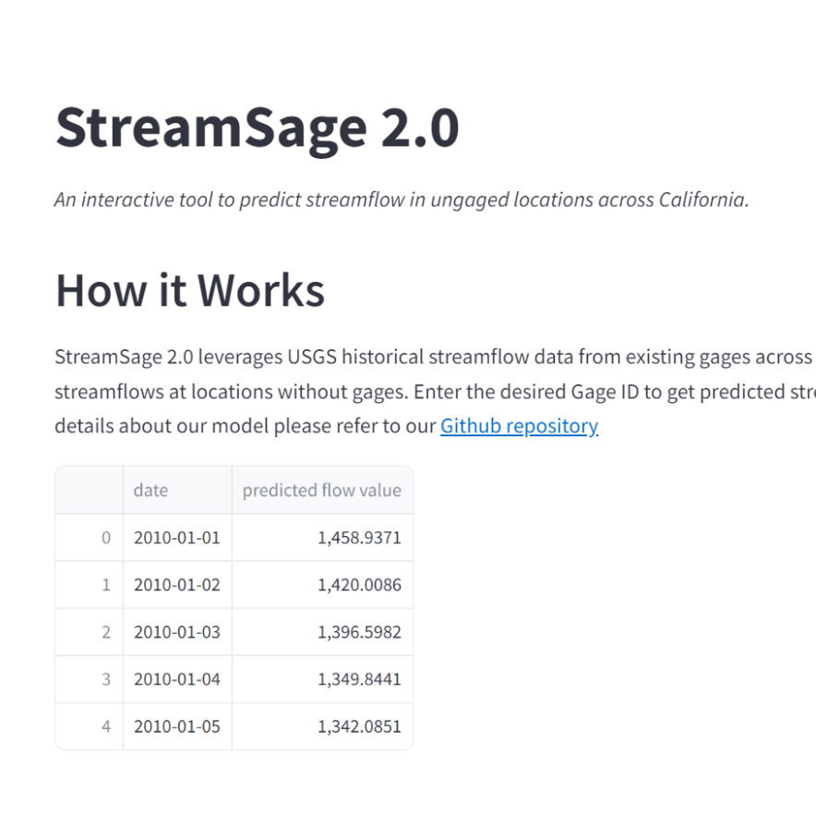
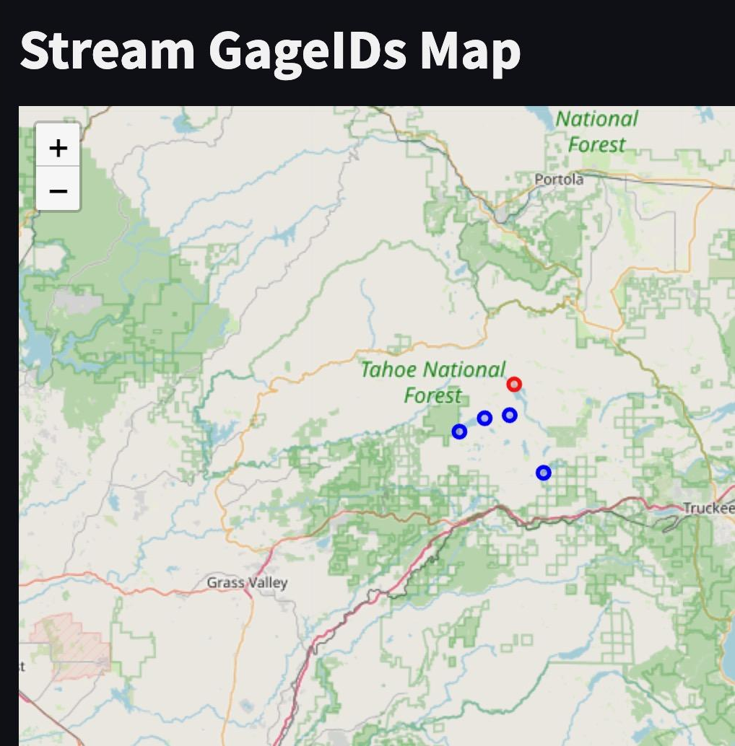
Demo
Notes:
Mark

Slide 22
Conclusion

Slide 23
Final Deliverables
Deliverable | Description
Expert Rescale Notebook | Cleaned implementation of expert rescale
Our Final Model Notebook | Similarity Measure+Dynamic Windowing+Expert Rescale
Models Performance | KGE and R^2 scores of our model and Upstream
Streamlit Github Repo | Streamlit codes to set up dashboard UI+Model+Data
Notes:
Christiana

Slide 24
Main Takeaways
Our model Streamsage 2.0 achieved improved performance with better systematic reference gages selection (similarity measure) and dynamic windowing.
Comparable with Upstream
Low computation cost
Streamlit is accessible and can be coded with only python
Good framework to build & deploy quick tools
Notes:
Christiana

Slide 25
Thank you!
Questions?

Slide 26
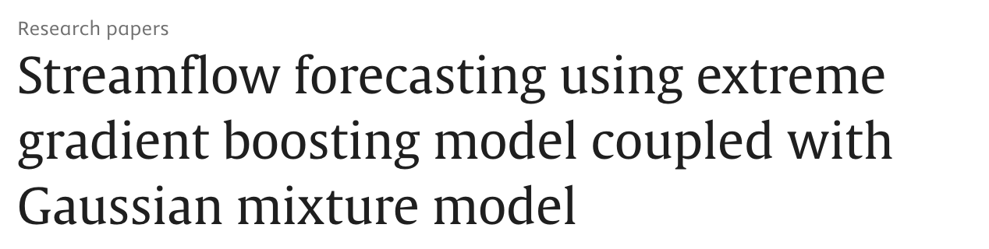
Next Steps
Weight Optimization: GMM-XGBoost
Gaussian Mixture Model (GMM): Cluster streamflow data into homogeneous groups
Makes probability
Extreme Gradient Boosting (XGBoost): Models trained on these clusters to predict actual stream flow with each XGBoost model specialized to predict within specific conditions of that cluster
Uses probability as weights
Output: Predicted Streamflow based on underlying probabilistic structure provided by GMM
https://www.sciencedirect.com/science/article/abs/pii/S0022169420303619
Notes:
Mark

Slide 27
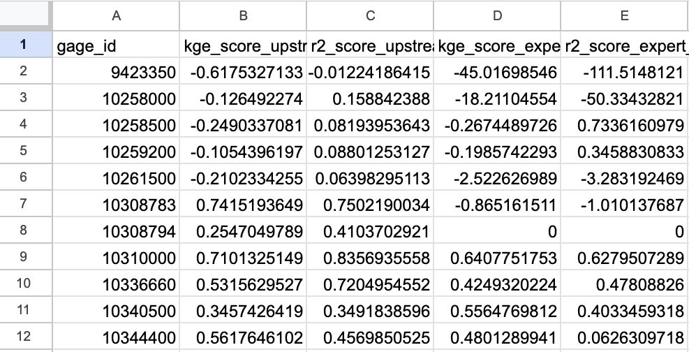
Models Comparison Pipeline
Dis gna be a screenshot of the csv

